Slide 1
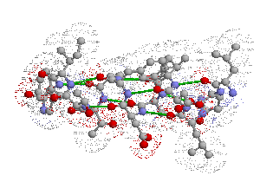
Protein Structure

Slide 2
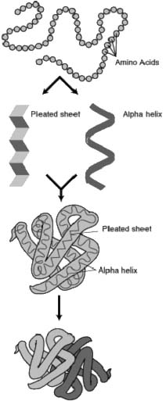
Biology/Chemistry of Protein Structure
Primary
Secondary
Tertiary
Quaternary
Assembly
Folding
Packing
Interaction
S T R U C T U R E
P R O C E S S

Slide 3
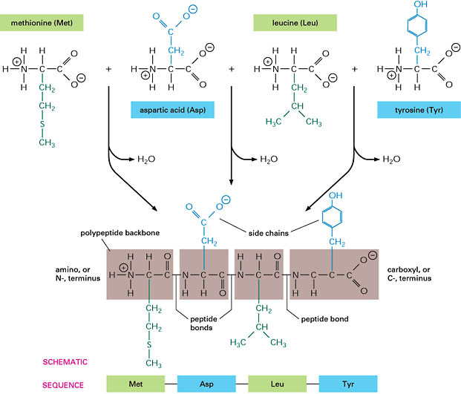
Protein Assembly
occurs at the ribosome
involves dehydration synthesis and polymerization of amino acids attached to tRNA:
NH - {A + B → A-B + H O} -COO
thermodynamically unfavorable, with ΔE = +10kJ/mol, thus coupled to reactions that act as sources of free energy
yields primary structure
+
-
3
2
n

Slide 4
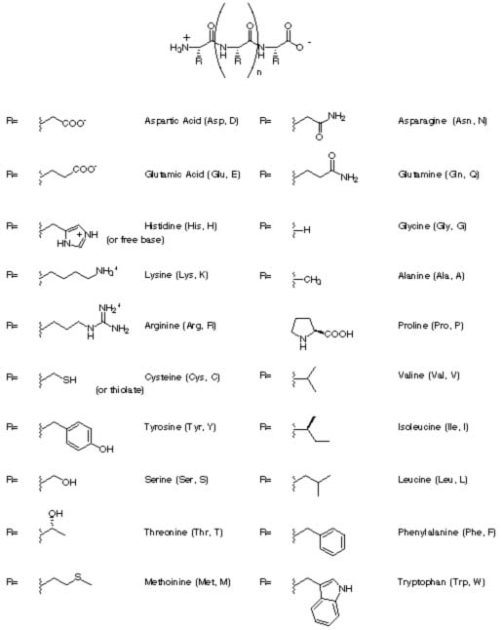
Primary Structure
primary structure of human insulin
CHAIN 1: GIVEQ CCTSI CSLYQ LENYC N
CHAIN 2: FVNQH LCGSH LVEAL YLVCG ERGFF YTPKT
linear
ordered
1 dimensional
sequence of amino acid polymer
by convention, written from amino end to carboxyl end
a perfectly linear amino acid polymer is neither functional nor energetically favorable → folding!

Slide 5
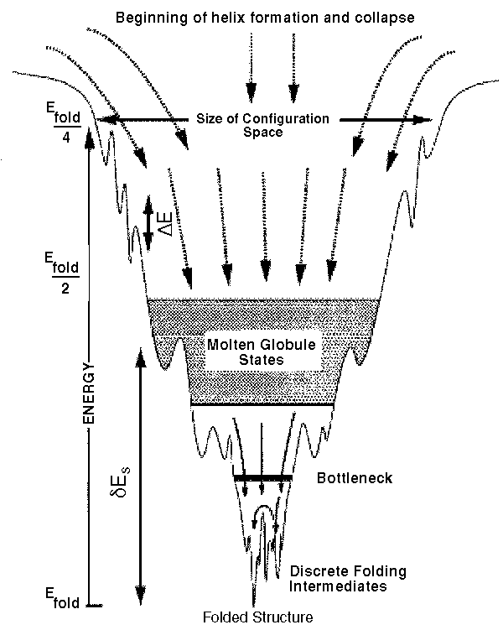
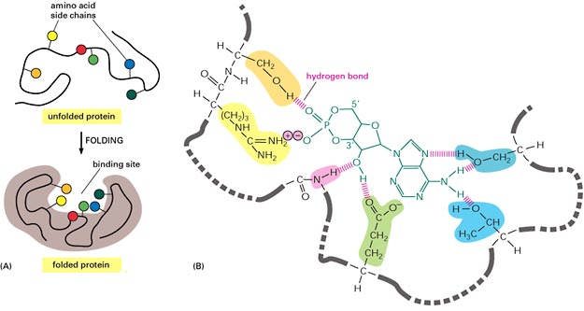
Protein Folding
occurs in the cytosol
involves localized spatial interaction among primary structure elements, i.e. the amino acids
may or may not involve chaperone proteins
tumbles towards conformations that reduce ΔE (this process is thermo-dynamically favorable)
yields secondary structure

Slide 6
Protein:Information
Heteropolymers and made up of 20 different L-α-amino acid
Thershold number of peptide bond to perform biochemical function by protein : >40.
Correlation between mRNA and protein:
Protein synthesis from mRNA
mRNA degradation can takes place after protein formation and still protein will exist
Ribosomes are the cell’s protein function

Slide 7
Amino acid
http://www.jalview.org/help/html/misc/aaproperties.html

Slide 8
Amino acid: basic properties

Slide 9
Amino acid: pK and pI

Slide 10
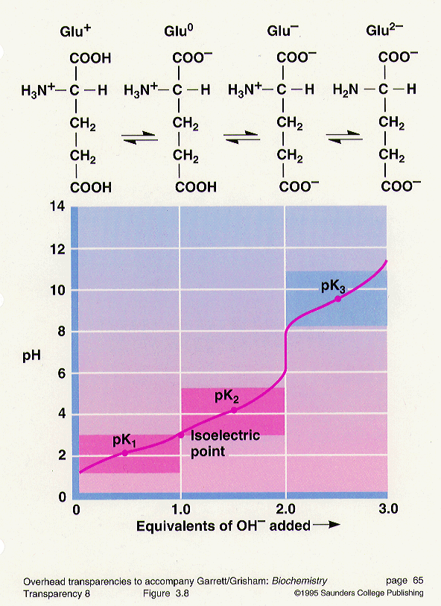
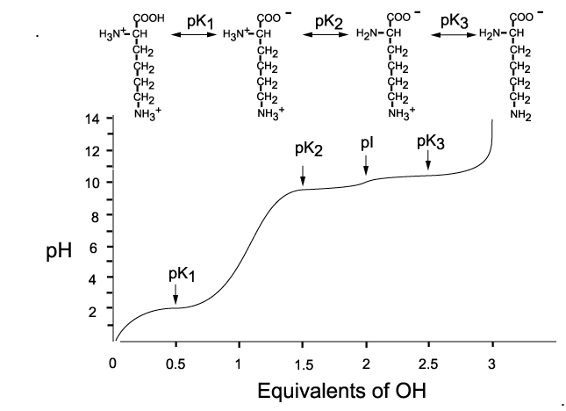
Lysine

Slide 11
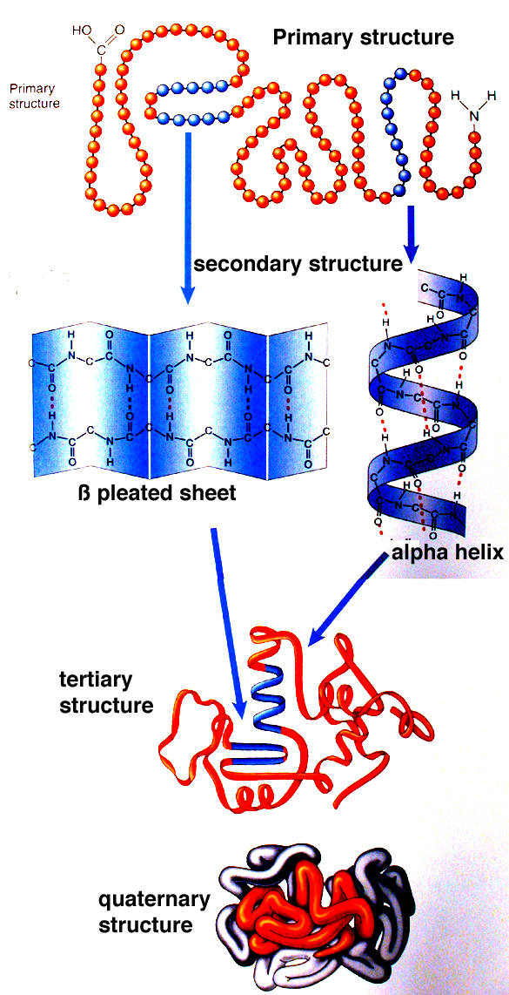

Slide 12
Secondary structure
Angle: phi, psi, omega
Structure:
Alpha helix,
Beta sheet,
Loops and turns,
Folds and motifs,
Turns or loop region,
Random coil

Slide 13
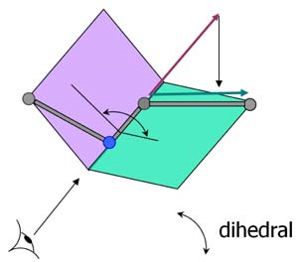

Slide 14
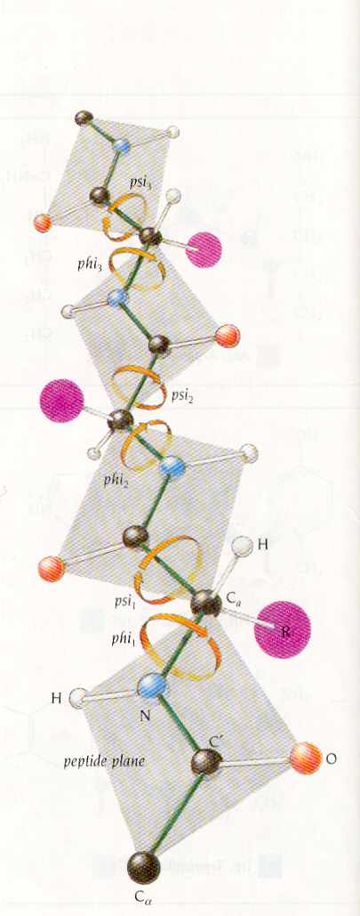

Slide 15
Information from PROCHECK
Ramachandran plot and other information
http://www.ebi.ac.uk/thornton-srv/software/PROCHECK/
About amino acid:
http://prowl.rockefeller.edu/aainfo/contents.htm

Slide 16
Ramachandran plot

Slide 17
Structural configuration for some amino acid
Structure configuration | Amino acid | Comments
Propensity for alpha helix | Ala, Leu, Glu | Smaller size and no bulkyness
Disrupt alpha helix | Ser, Asp, Asn
Propensity for beta-sheets, also disrupt alpha helix | Val and Ile | Side chain project out of plane and thus conducive to sheet
Propensity for turns | Gly, Pro, Asp

Slide 18
Components of Tertiary Structure
Fold – used differently in different contexts – most broadly a reproducible and recognizable 3 dimensional arrangement
Domain – a compact and self folding component of the protein that usually represents a discreet structural and functional unit
Motif (aka supersecondary structure) a recognizable subcomponent of the fold – several motifs usually comprise a domain
Like all fields these terms are not used strictly making capturing data that conforms to these terms all the more difficult

